Slide 1

Capstone Project 1 - Aortic Disease Prediction
Made by Saransh Shukla
Batch: DST 20823
Submitted to Mr. Kevin Shah

Slide 2
Problem statement
Despite the advancements in medical imaging and diagnostic techniques, the early detection and prediction of Aortic diseases remain challenging. The utilization of machine learning algorithms presents an opportunity to enhance predictive models using the Statlog dataset. However, developing accurate and reliable machine learning models for Aortic Disease Prediction requires addressing various challenges such as data heterogeneity, feature selection, and model interpretability. This project aims to explore and overcome these challenges to develop a robust and clinically relevant predictive model for Aortic diseases using the Statlog dataset.

Slide 3
Different Approaches Considered
Intuitive K-Nearest Neighbors (KNN): Considering the simplicity of the dataset, contemplated the use of KNN for its intuitive approach to classifying instances based on their proximity, allowing for easy interpretation and understanding.
Versatile Support Vector Machine (SVM): Explored SVM as a versatile option for its ability to handle complex relationships in the data, pondering its potential to effectively classify instances in the context of aortic heart disease prediction.
Insightful Decision Trees for Transparency: Contemplated the adoption of decision trees to ensure transparency in the decision-making process, enabling a clear understanding of how different features contribute to the classification.
Probabilistic Naive Bayes: Considered Naive Bayes for its probabilistic approach, envisioning its potential in handling the simplicity of the dataset while providing a solid foundation for probability-based classification.
Simplicity in Logistic Regression: Explored Logistic Regression as a straightforward approach, contemplating its simplicity and interpretability for binary classification tasks, aligning with the project's focus on aortic heart disease prediction.
Random Forest for Ensemble Learning: Deliberated the use of Random Forest for its ensemble learning capability, contemplating the aggregation of decision trees to enhance predictive performance and robustness.
Voting Classifier for Model Aggregation: Considered a Voting Classifier to combine predictions from multiple models, envisioning its potential to improve overall accuracy by leveraging diverse algorithms for aortic heart disease prediction.

Slide 4
Approach which I Used
K-Nearest Neighbors (KNN): Chose KNN for its simplicity and effectiveness in capturing local patterns. Given the straightforward nature of the dataset, KNN's proximity-based approach aligned well with the project's objectives.
Support Vector Machine (SVM): Opted for SVM due to its capability to handle complex relationships in the data. Recognizing the potential nuances in aortic heart disease prediction, SVM offered a robust solution for effective classification.
Decision Trees for Transparency: Implemented decision trees to ensure transparency in the decision-making process. The interpretability of decision trees was crucial for gaining insights into the key features contributing to predictions.
Probabilistic Naive Bayes: Utilized Naive Bayes for its probabilistic approach, suitable for handling the simplicity of the dataset. The model's efficiency in high-dimensional spaces and assumption of feature independence complemented the project's requirements.
Simplicity in Logistic Regression: Employed Logistic Regression for its simplicity and interpretability. As a binary classification task, the straightforward nature of Logistic Regression aligned well with the project's focus on aortic heart disease prediction.
Exclusion of Random Forest and Voting Classifier:
Random Forest: The dataset's simplicity and the interpretability focus led to the exclusion of Random Forest. While powerful for ensemble learning, its complexity wasn't deemed necessary, and individual decision trees sufficed for the project.
Voting Classifier: Omitted Voting Classifier as combining models didn't offer substantial advantages for this specific project. The ensemble approach didn't significantly enhance predictive performance, making the simpler models more suitable for the task at hand.

Slide 5
Details of Project Execution:
Dataset Acquisition:
Downloaded the dataset from Kaggle to initiate the project on aortic heart disease prediction.
Data Loading and Cleaning:
Loaded the dataset into the program.
Conducted thorough data cleaning, checking for null and duplicate values, and ensured a pristine dataset.
Data Splitting:
Split the dataset into 80% for training and 20% for testing to assess model generalization.
Correlation Analysis:
Investigated feature correlation to understand relationships among variables.
Data Preprocessing:
Separated data into predictor features and target variables.
Applied labeling and standardization to ensure uniformity across the dataset.
Model Training:
Implemented five chosen models (KNN, SVM, Decision Trees, Naive Bayes, Logistic Regression) for training.
Observed that SVM and Decision Trees demonstrated superior performance during training.
Model Evaluation on Test Dataset:
Assessed model performance on the test dataset.
Surprisingly, Logistic Regression and SVM outperformed others on the test set, indicating robust generalization.
Overall Best Model: Logistic Regression:
Despite comparatively lower performance on the training dataset, Logistic Regression emerged as the overall best model.
Showcased exceptional performance on the test dataset, highlighting its suitability for aortic heart disease prediction in real-world scenarios.

Slide 6

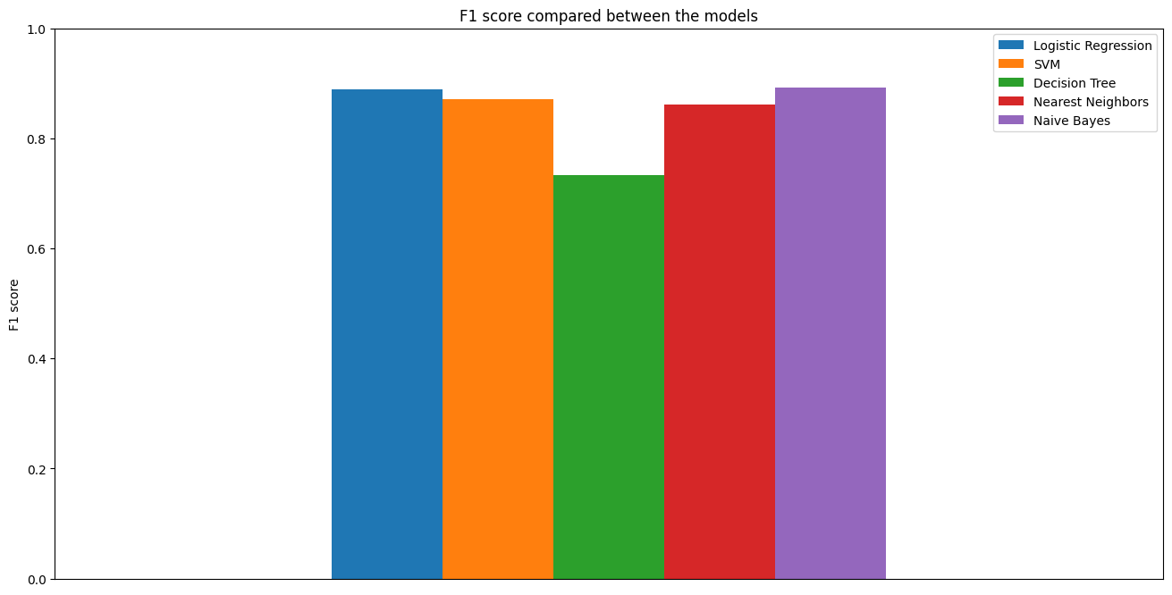
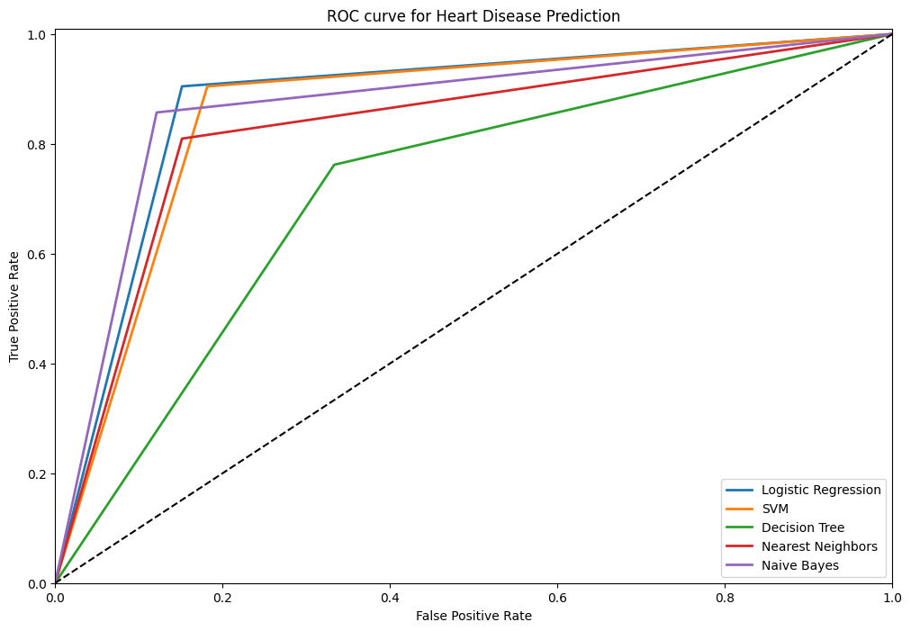
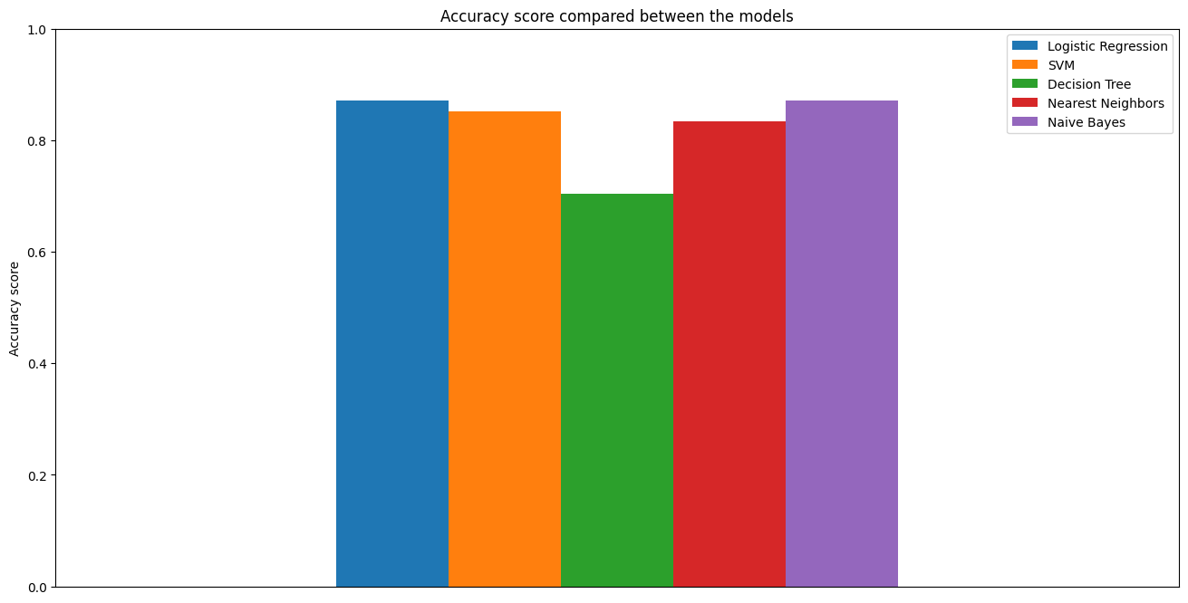
Results

Slide 7
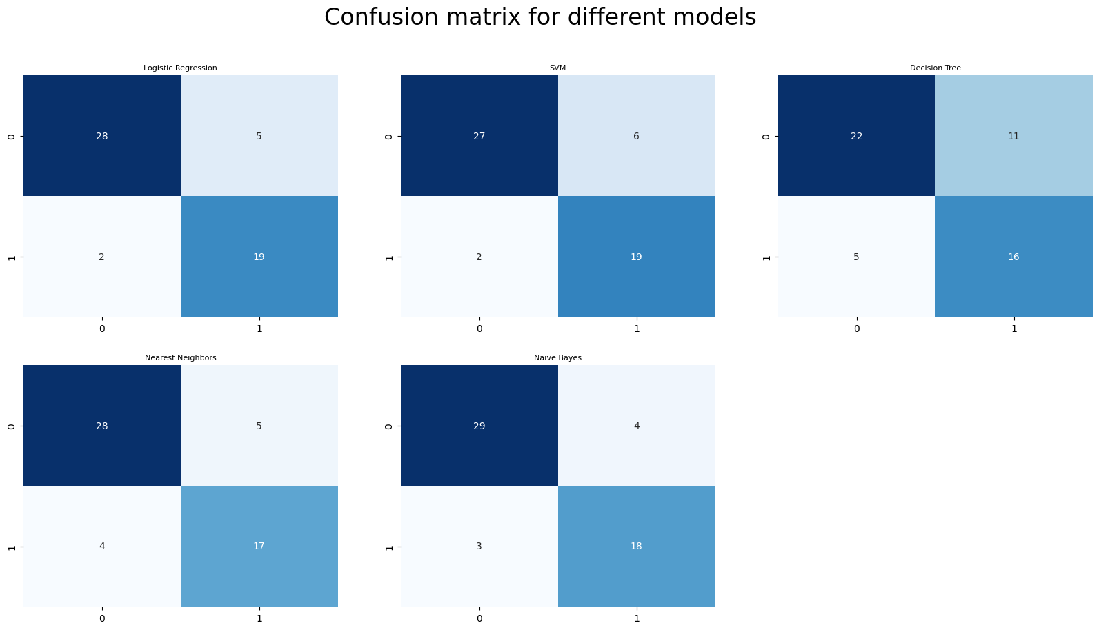


Slide 8
Thank You

